Slide 1
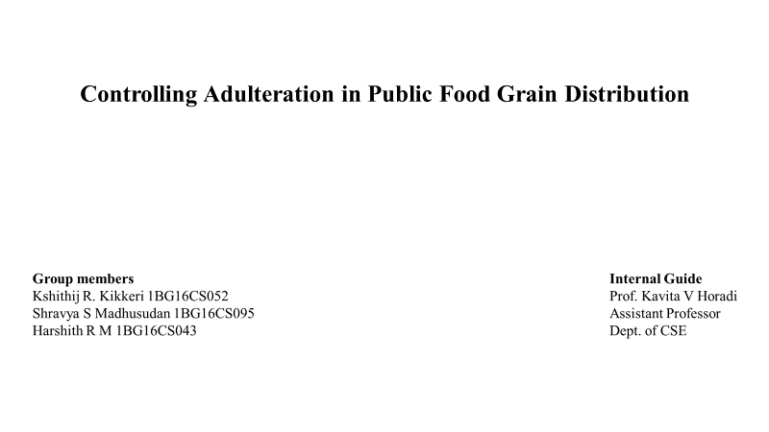
Controlling Adulteration in public food distribution system

Slide 2
Contents
Introduction
Objective
System Design
Data Flow Diagram (DFD)
Sequence Diagram

Slide 3
Introduction
Rice (Oryza sativa L.) is an essential staple food for half of the global population. Rice grains of hundreds of varieties are cultivated and traded in considerable amounts worldwide.
Various genetic marker-based methods have been applied for identifying rice grain varieties.
They combine image analysis and machine learning techniques to achieve automatic inspection and evaluation.
Human perception has long been recognized as a guide to quality assessment but the results are not accurate and is unreliable.

Slide 4
Existing System
The existing systems suggest that the manual classification and segregation can be done using the processes of sieving, cleaning, milling among the others.
On the other hand, automated process using advanced techniques are done using algorithms like K-Means clustering algorithm, K-Nearest neighbor algorithm, morphological feature extraction and Detection.
Not highly secure and hence leads to inconsistency and tampering of food grains for illicit purposes.
Immediate disbursal of the food grains does not take place which results in rotting of food grains due to inexplicable weather conditions.

Slide 5
Proposed System
First, capture the image of the grain using a digital camera
Store them in the database file, read that database file and then pre-process the image
Then perform segmentation to extract each grain image. Extract the features from each segmented image, store the extracted features in feature vector for training
The features of the colour, shape and size of the rice grains in order to grade them for quality
Build the Probabilistic Neural Network (PNN) for training and recognizing the grain type and its quality. Finally, test the system by giving different images as input

Slide 6
Sequence Diagram
Input image for rice image
Preprocessing
Images resize and gray conversion
Clustering
Feature extraction
PNN classification
Determination of Good/Average/Bad

Slide 7
Data Flow Diagram
Rice grain images
Dataset
Feature Extraction
HOG, Length, Area, Perimeter
Input image
Classification
Probabilistic Neural Networks
Gray and binary conversion for input image
Preprocessing
Shape recognition
Back ground subtraction
Segmentation

Slide 8
Thank You

